Slide 1
TOOP19 Introduction to Object-Oriented Analysis, Design and Programming
Primary Reference:
Object-Oriented Programming C++ Simplified by Hari Mohan Pandey
Available at https://uscg.skillport.com
Object-Oriented Exercise Developed by 1/c Jacob Schellman

Slide 2
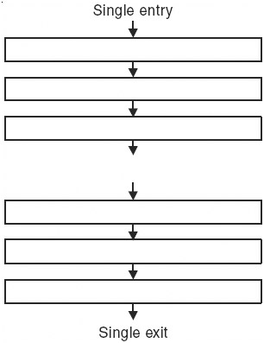
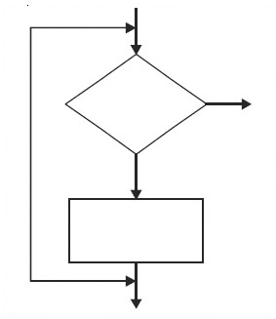
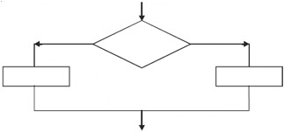
Introduction to OOP
Structured (Procedural) Programming
Structured programming was first suggested by Corrado Bohm and Guiseppe Jacopini in 1966. The two mathematicians demonstrated that any computer program can be written with just three structures:
Sequences Decision Loops

Slide 3
Characteristics of Procedure-Oriented Programming
Follow top-down approach.
Data is given less importance than function.
Vulnerability of data is there as functions share global data.
Functions can manipulate global data, without letting other functions know.
Big program is divided into small modules.
Algorithms are designed first without bothering about minute details.

Slide 4
Object-Oriented Programming
A computer program may be seen as comprising a collection of individual units, or objects, that act on each other, as opposed to a traditional view in which a program may be seen as a collection of functions or simply as a list of instruction to the computer.
Each object can receive messages, processing data, and sending messages to other objects.
There are eight basic concepts of OOP:
Class and Object
Encapsulation
Abstraction
Data Hiding
Polymorphism
Inheritance
Dynamic Binding
Message Passing

Slide 5
1. Class and Object
A class is a collection of function code and data which forms the basic of object-oriented programming.
A class is an Abstract Data Type (ADT) i.e., the class definition only provides the logical abstraction. The data and function defined within the class spring to life only when a variable of type class is created.
The variable of type class is called an object which has a physical existence and also known as an instance of class. From one class several objects can be created. Each object has similar set of data defined in the class and it can use functions defined in the class for the manipulation of data.
Objects are the basic run time entity in a C++ program. All objects are instances of a class.
Depending upon type of class an object may represent anything like a person, or mobile phone, chair, student, employee, or anything which we see in our daily life. The state of an object is determined by the data values they are having at a particular instances. Objects occupy space in memory. Two objects may communicate with each other through functions by passing messages.
In summary:
Animal can be stated as a class and Lion, Tiger, Elephant, Wolf, Cow, etc., are its object.
Bird can be stated as class and Sparrow, Eagle, Hawk, Pigeon etc., are its objects.
Notes:
For example : we can created a class car which have properties like company, model, year of manufacture, fuel type etc., and which may have actions like acceleration (), brake () etc.

Slide 6
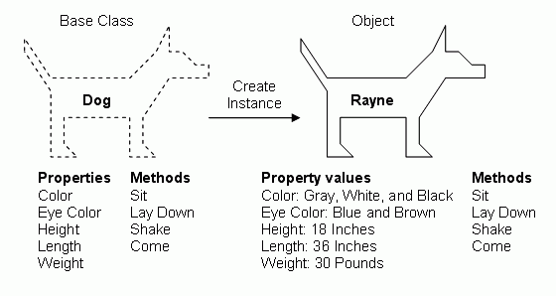
1. Class and Object
A class is a collection of function code and data which forms the basic of object-oriented programming.
A class is an Abstract Data Type (ADT) i.e., the class definition only provides the logical abstraction. The data and function defined within the class spring to life only when a variable of type class is created.
The variable of type class is called an object which has a physical existence and also known as an instance of class. From one class several objects can be created. Each object has similar set of data defined in the class and it can use functions defined in the class for the manipulation of data.
Objects are the basic run time entity in a C++ program. All objects are instances of a class.
Depending upon type of class an object may represent anything like a person, or mobile phone, chair, student, employee, or anything which we see in our daily life. The state of an object is determined by the data values they are having at a particular instances. Objects occupy space in memory. Two objects may communicate with each other through functions by passing messages.
In summary:
Animal can be stated as a class and Lion, Tiger, Elephant, Wolf, Cow, etc., are its object.
Bird can be stated as class and Sparrow, Eagle, Hawk, Pigeon etc., are its objects.
Notes:
For example : we can created a class car which have properties like company, model, year of manufacture, fuel type etc., and which may have actions like acceleration (), brake () etc.

Slide 7
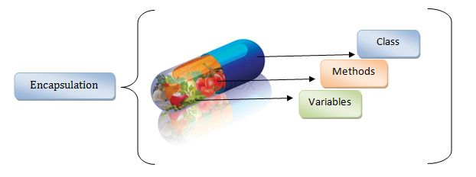
2. Encapsulation
Encapsulation is the mechanism that combines function and data in one compact form known as a class.
The data and function may be private or public.
Private data/function can only be accessed only within the class.
Public data/code can be accessed outside the class.
Linking of function code and data together gives rise to objects.

Slide 8
3. Abstraction
Abstraction is a mechanism to represent only essential features which are of significance and hides the unimportant details.
As an example of the abstraction consider a class Vehicle.
When we create the Vehicle class, we can decide what function code and data to put in the class like vehicle name, number of wheels, fuel type, vehicle type etc., and functions like changing the gear, accelerating/decelerating the vehicle.
We are also not interested in making more parts of the vehicle to be part of the class like VIN, model number, vehicle color, etc.
Notes:
To make a good abstraction we require a sound knowledge of the problem domain which we are going to implement using OOP principle.

Slide 9
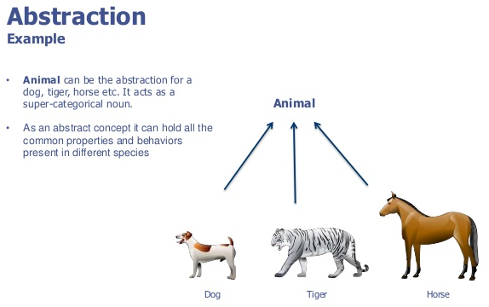
3. Abstraction
Abstraction is a mechanism to represent only essential features which are of significance and hides the unimportant details.
As an example of the abstraction consider a class Vehicle.
When we create the Vehicle class, we can decide what function code and data to put in the class like vehicle name, number of wheels, fuel type, vehicle type etc., and functions like changing the gear, accelerating/decelerating the vehicle.
We are also not interested in making more parts of the vehicle to be part of the class like VIN, model number, vehicle color, etc.
Notes:
To make a good abstraction we require a sound knowledge of the problem domain which we are going to implement using OOP principle.

Slide 10
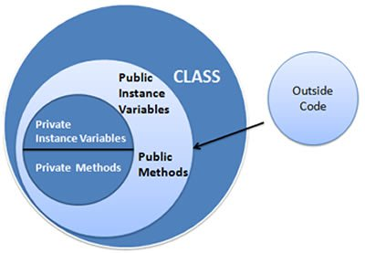
4. Data Hiding
Data hiding hides the data from external access by the user. In OOP language we have special keywords like private, protected etc., which hides the data.

Slide 11
5. Polymorphism
"Poly" means many and "Morphism" means form.
Thus, polymorphism means more than one form and provides a way for an entity to behave in several ways.
It is an attribute that allows one interface to control access to a general class of actions.
For example, we want to find out maximum of three numbers; no matter what type of input we pass i.e., integer, float etc. Because of polymorphism we can define three variable versions of the same function with the name max3. Each version of this function takes 3 parameters of the same time i.e., one version of max3 takes 3 arguments of type integer, another takes 3 arguments of type double and so on. The compiler automatically selects the right version of the function depending upon the type of data passed to the function max3. This also termed as function polymorphism or function overloading.
Notes:
Polymorphism is of two types which are given below :
Compile time polymorphism.
Run time polymorphism.

Slide 12
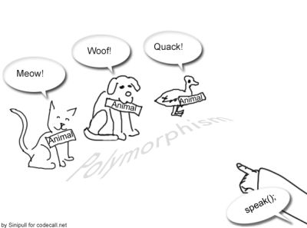
5. Polymorphism
"Poly" means many and "Morphism" means form.
Thus, polymorphism means more than one form and provides a way for an entity to behave in several ways.
It is an attribute that allows one interface to control access to a general class of actions.
For example, we want to find out maximum of three numbers; no matter what type of input we pass i.e., integer, float etc. Because of polymorphism we can define three variable versions of the same function with the name max3. Each version of this function takes 3 parameters of the same time i.e., one version of max3 takes 3 arguments of type integer, another takes 3 arguments of type double and so on. The compiler automatically selects the right version of the function depending upon the type of data passed to the function max3. This also termed as function polymorphism or function overloading.
Notes:
Polymorphism is of two types which are given below :
Compile time polymorphism.
Run time polymorphism.

Slide 13
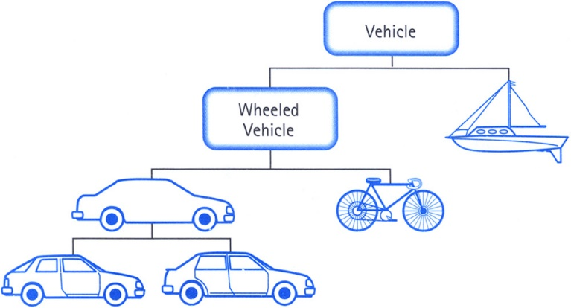
6. Inheritance
Inheritance is the mechanism of deriving a new class from the earlier existing class.
Inheritance provides the basic idea of reusability in Object-oriented Programming. The new class inherits the features of the old class. The old class and new class is called base-derived, parent-child, or super-sub.
Inheritance supports the idea of classification. In classification we can form hierarchies of different classes each of which having some special characteristics besides some common properties.
Notes:
Through classification a class need only definition those qualities that make it unique within its class.

Slide 14
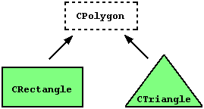
Inheritance Example
Which properties does a rectangle have?
Which properties does a triangle have?
Notes:
Color, length, height, area, circumference
Color, side1, side2, side3, area, circumference

Slide 15
7. Dynamic Binding
Binding means linking. It is linking of function definition to a function call.
If linking of function call to function definition i.e., a place where control has to be transferred is done at compile time, it is known as static binding.
When linking is delayed till run time or done during the execution of the program then this type of linking is known as dynamic binding. Which function will be called in response to a function call is find out when program executes.

Slide 16
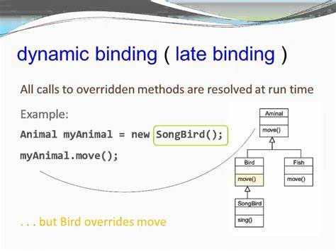
7. Dynamic Binding
Binding means linking. It is linking of function definition to a function call.
If linking of function call to function definition i.e., a place where control has to be transferred is done at compile time, it is known as static binding.
When linking is delayed till run time or done during the execution of the program then this type of linking is known as dynamic binding. Which function will be called in response to a function call is find out when program executes.

Slide 17
8. Message Passing
In C++ objects communicate each other by passing messages to each other. A message contains the name of the member function and arguments to pass. In message passing shown below :
object. method (parameters);
Message passing here means object calling the method and passing parameters. Message passing is nothing but the calling the method of the class and sending parameters. The method in turn executes in response to a message.

Slide 18
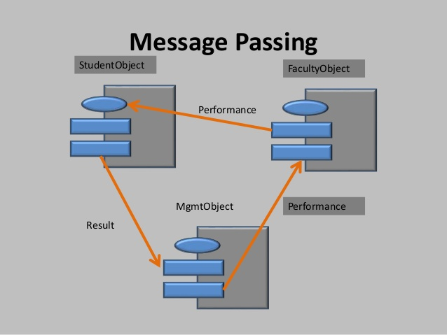
8. Message Passing
In C++ objects communicate each other by passing messages to each other. A message contains the name of the member function and arguments to pass. In message passing shown below :
object. method (parameters);
Message passing here means object calling the method and passing parameters. Message passing is nothing but the calling the method of the class and sending parameters. The method in turn executes in response to a message.

Slide 19
OOP Characteristics (Summary)
Programs are divided into classes and functions (methods).
Data is hidden and cannot be accessed by external functions.
Use of inheritance provides reusability of code.
New functions and data items can be added easily.
Generally follows a bottom-up approach.
Data and functions are tied together in a single unit known as class.
Objects communicate each other by sending messages (in the form of function calls).

Slide 20
Advantages of Object-Oriented Programming
Code reusability in terms of inheritance.
Object-oriented system can be easily upgraded from one platform to another.
Complex projects can be easily divided into small code functions.
The principle of abstraction and encapsulation enables a programmer to build secure programs.
Software complexity decreases.
Principle of data hiding helps programmer to design and develop safe programs.
Rapid development of software can be done is short span of time.
More than one instance of same class can exist together without any interference.

Slide 21
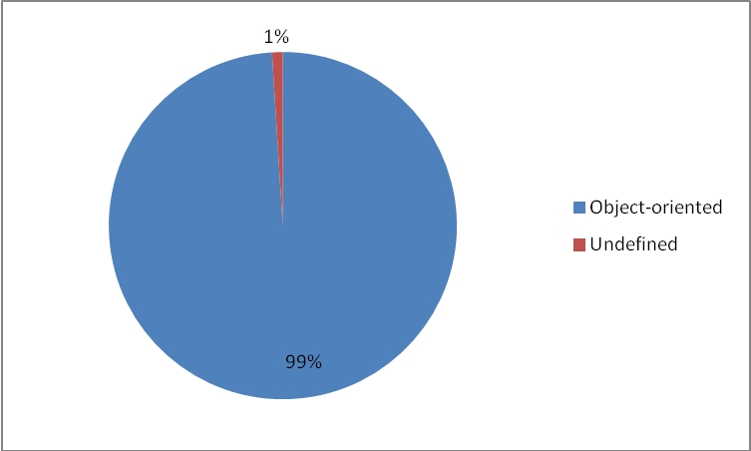
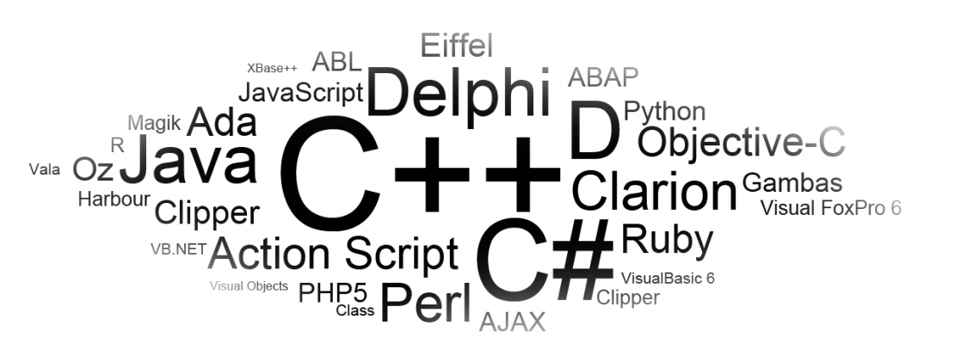
Object-Oriented Languages
Breakdown of Languages Used in Mobile Development
Source: http://www.kamyacademy.com/en/starting-point-object-oriented-programming/

Slide 22
Introduction of Object-Oriented Design
Object-Oriented Analysis
The purpose of object-oriented analysis, as with all other analysis, is to obtain an understanding of the application
An understanding depending only on the system's functional requirements
Object-oriented analysis is a method of analysis that examines requirements from the perspective of the classes and objects found in the vocabulary of the problem domain.
Object-Oriented Analysis contains, in some order, the following activities :
Finding the object.
Organizations the objects.
Describing how the objects interact.
Defining the operations of the objects.
Defining the objects internally.
Notes:
The aim is to introduce the actual idea, not to give strict and precise definition.
1.7 Finding the Objects
The objects can be found as naturally occurring entries in the application domain. The aim is to find the essential objects, which are to obtain which are to remain essential throughout the system life cycle. Stability also depends on the fact that modifications often begin from some of these items and therefore are local. For example, in a application for controlling for water tank, typically objects would include contained water, regulator, valve and tank.

Slide 23
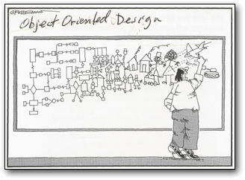
Introduction of Object-Oriented Design
Object-Oriented Design
Object-oriented design is a method of design encompassing the process of object-oriented decomposition.
Notes:
and a notation for depicting both logical and physical as well as static and dynamic models of the system under design

Slide 24
Introduction of Object-Oriented Design
Object-Oriented Programming
Object-oriented programming is a method of implementation in which programs are organized as cooperative collections of objects, each of which represents an instance of some class, and whose classes are all members of a hierarchy of classes united via inheritance relationships.
Object-oriented programming uses objects, not algorithms, as its fundamental logical building blocks.
Each object is an instance of some class. Classes are related to one another via inheritance relationships. A program may appear to be object-oriented, but if any of these elements is missing, it is not an object-oriented program.
Notes:
It supports objects that are data abstractions with an interface of named operations and a hidden local state.
Objects have an associated type (class).
Types (classes) may inherit attributes from super types (super classes).

Slide 25
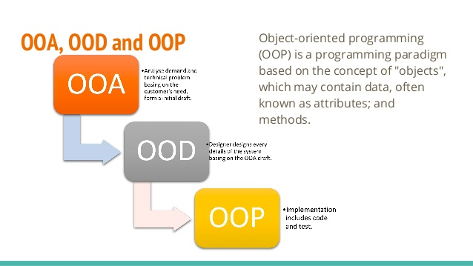
How are OOA, OOD, and OOP related?
Basically:
The products of object-oriented analysis serve as the models from which we may start an object-oriented design;
The products of object-oriented design can then be used as blueprints for completely implementing a system using object-oriented programming methods.

Slide 26
In-Class Exercise

